Slide 1


Smart Attendance System using Face Recognition(SASFR)

Slide 2

Group Information
Enrolment No. | Name
205220694081 | Saifullah Rahimi
Internal Guide:-
Prof. Nootan Padia
External Guide:-
Mr. Venkata Srihari

Slide 3


Company Details
Solution Analysts
CEO: Mr. Kalpesh Patel
Software company
Address: A-106, Sankalp Iconic Tower Near Iscon Cross Road, Ambli - Bopal Rd, Ahmedabad, Gujarat 380058

Slide 4

Contents
Introduction
System Design
Implementation:
Image Acquisition
Image Processing
Feature Extraction
Face Recognition
How system will work?
Advantages
Disadvantages
Applications
Q & A

Slide 5
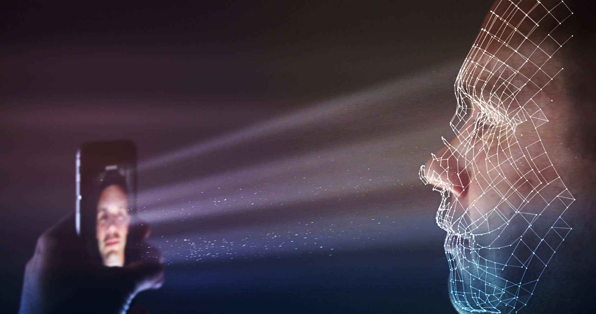
Introduction
Face Recognition is a bio-metric method of identifying an individual by comparing live capture or digital image data with the stored record for that person.
Smart Attendance System is marking of attendance based on this technology, which provides an automated attendance system that is practical,reliable and eliminate disturbance and time loss of traditional attendance systems.

Slide 6



System Design
This software project will be designed using Django framework.
The design part of the attendance monitoring system is divided into two sections:-
Hardware:-
Processor – i3
Hard Disk – 5 GB
Software

Slide 7
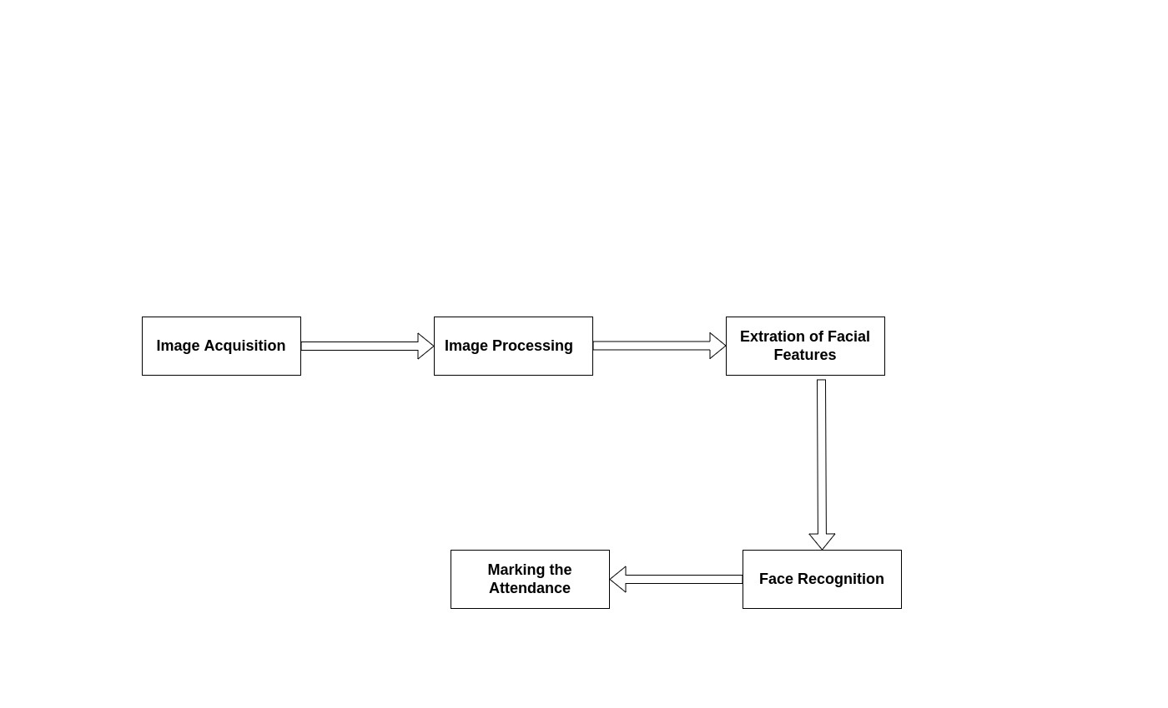
Implementation
The implementation of face recognition technology includes the following phases:
Image Acquisition
Image Processing
Facial feature Extraction
Face Recognition

Slide 8
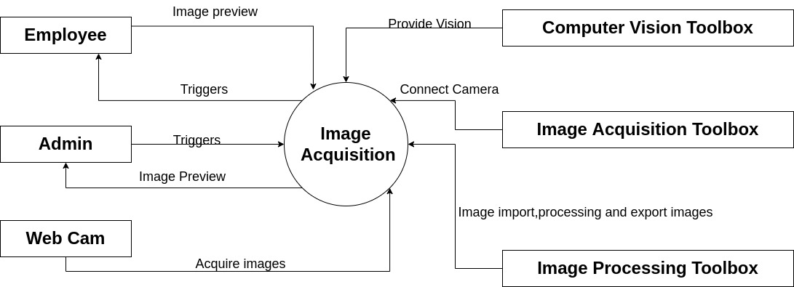
Image Acuisition
Image acquisition is an action of retrieving image from an external source for further processing.

Slide 9
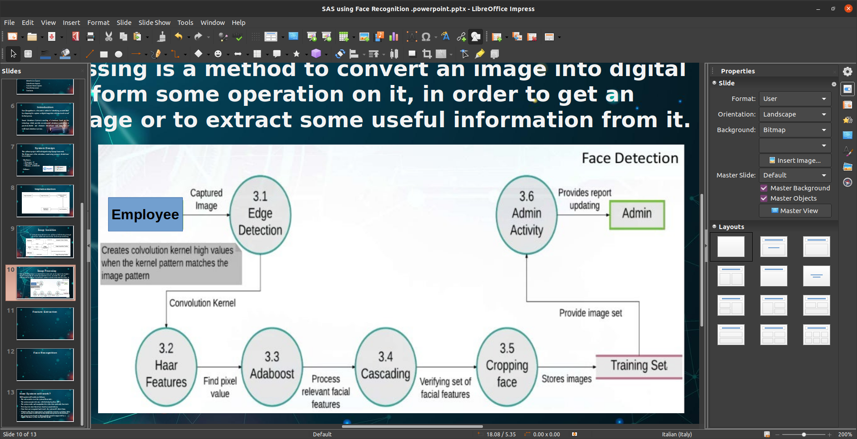
Image Processing
Image Processing is a method to convert an image into digital form and perform some operation on it, in order to get an enhanced image or to extract some useful information from it.

Slide 10
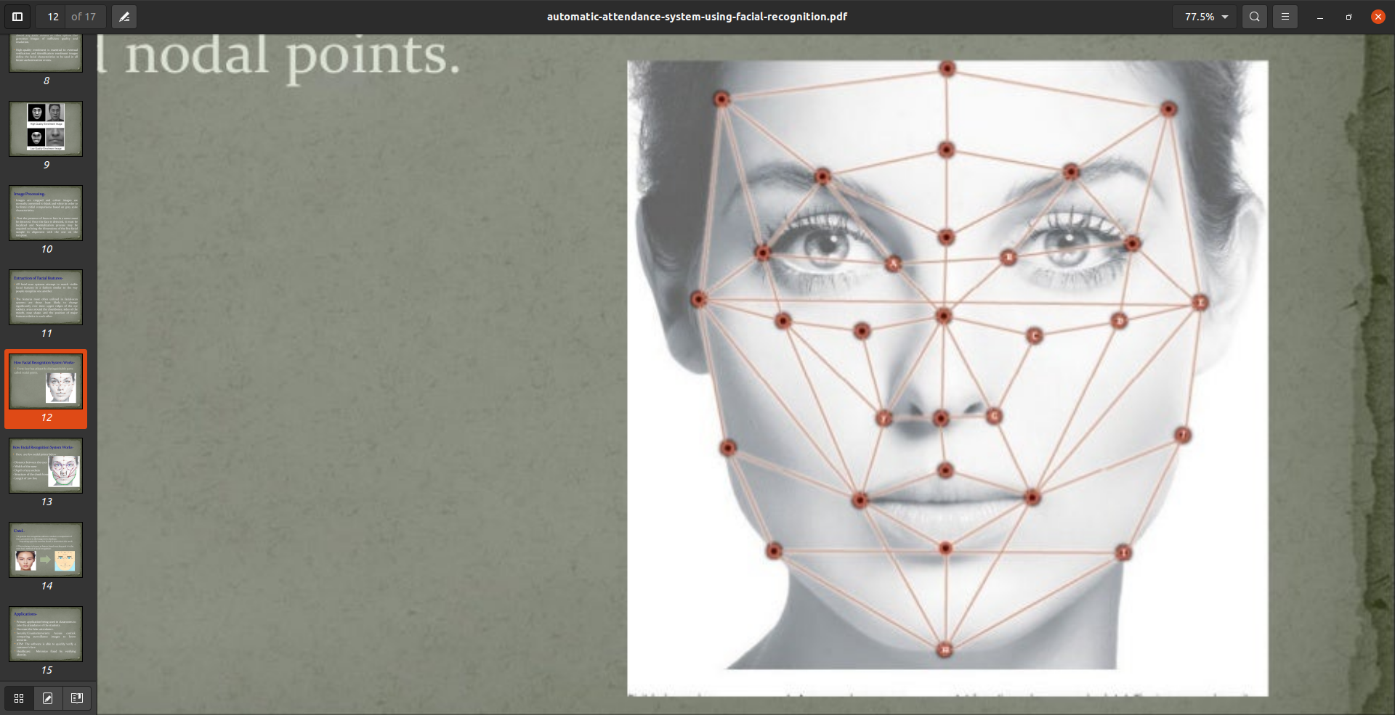
Feature Extraction
All facial scan systems attempt to match visible facial features in a fashion similar to the way people recognize one another.
The features most often utilized in facial-scan systems are those least likely to change significantly over time: upper ridges of the eyes sockets,areas around the cheekbones,sides of the mouth,nose shape and feature relative to each other.

Slide 11
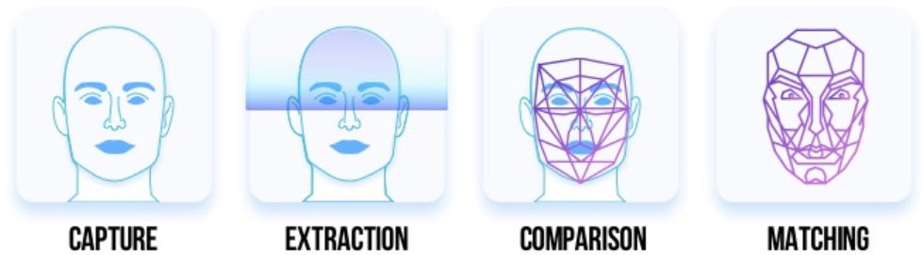
Face Recognition
Every face has at least 80 distinguishable parts called nodal points.
SAS by using face recognition concept conducts a comparison of these parameters to the images in its database.
Depending upon the matches found, it determines the result.
This technique is known as feature based matching.

Slide 12
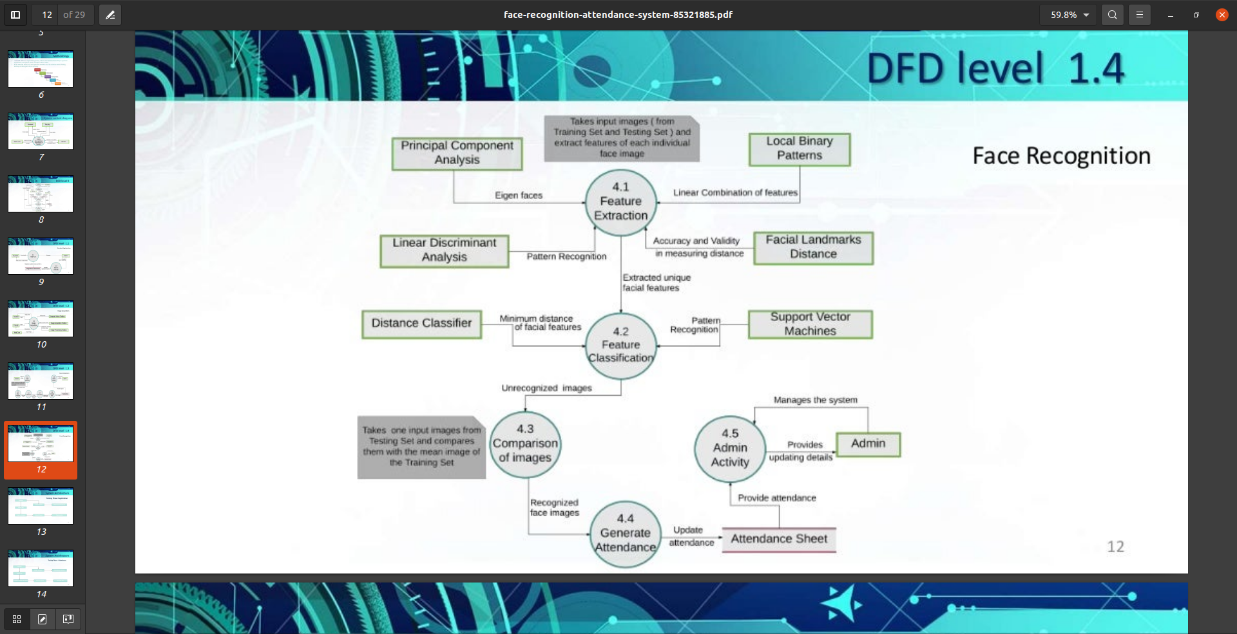
SAS Face Recognition Module

Slide 13
How System will work?
SAS system will works as follows:
The user needs to start the system(Client side).
The system accepts web cam with the help of python API’s.
The system works and manipulates live video data to identify faces in it.
Next step is to store these faces based on a matrix form.
Once faces are recognized and stored , the system will detect them.
Whenever the face reappears it is recognized by name in a real time video and an attendance is marked.
The project is will develop on python framework( Django) and is supported by a SqlLite database to store user specific details.

Slide 14
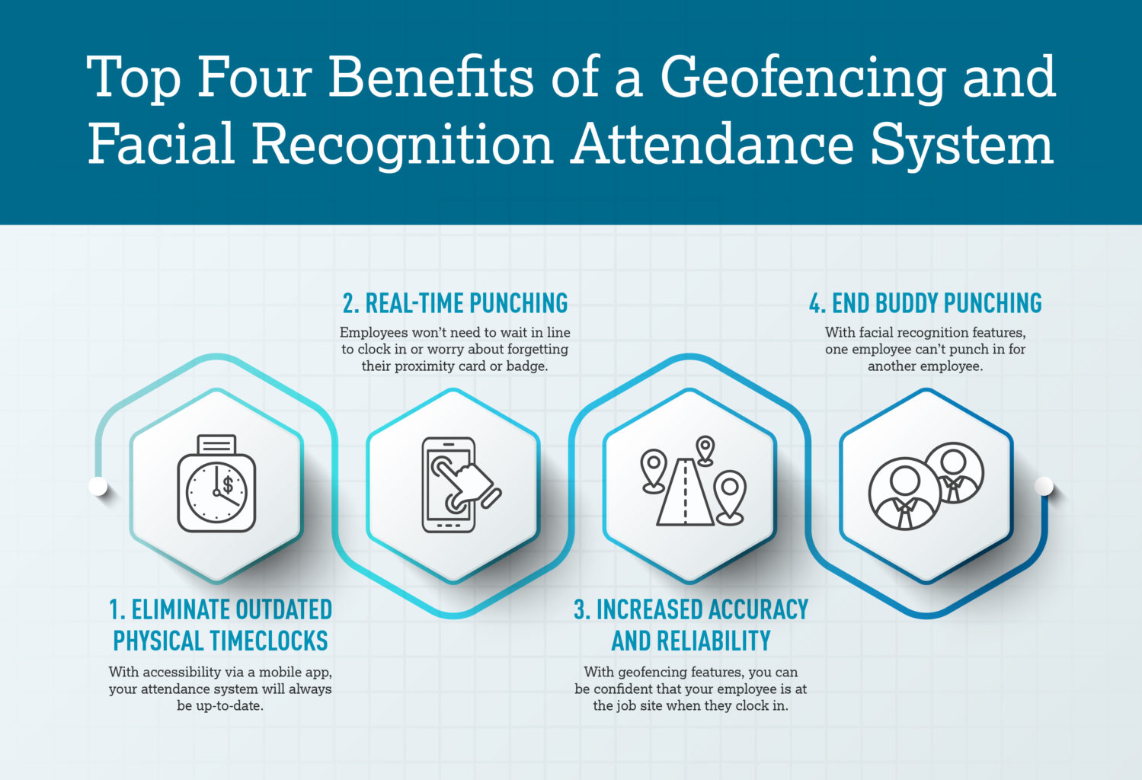
Advantages
The software can be used for security purposes in organizations and in secured zones.
The system is convenient and
secure for the users.
It saves their time and efforts.

Slide 15
Disadvantages
The system don’t recognize properly in poor light so may give false results.
It can only detect face from a limited distance.

Slide 16
Applications
The system can be used for places that require security like bank, military etc.
It can also be used in houses and society to recognize the outsiders and save their identity.
The software can used to mark attendance based on face recognition in organizations.

Slide 17

Any Questions

Slide 18
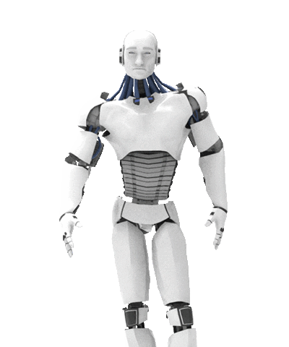
Thank You

